Slide 1
Suicide mission to Red Planet
2023

Slide 2
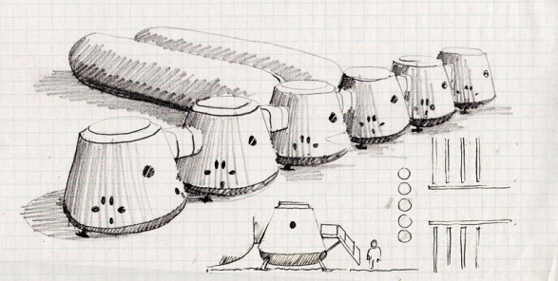
2011
In 2011 NASA began the creation of the first plans.

Slide 3
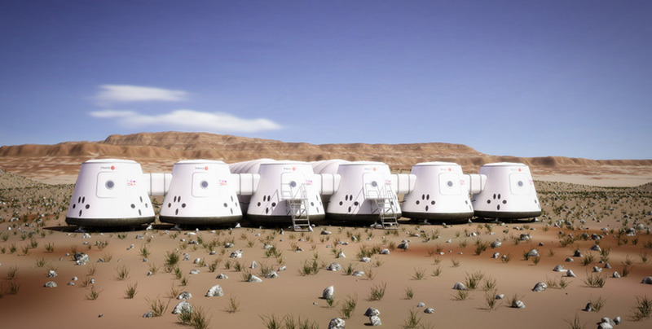
2013
Crowdsourced selection of first four astronauts.

Slide 4
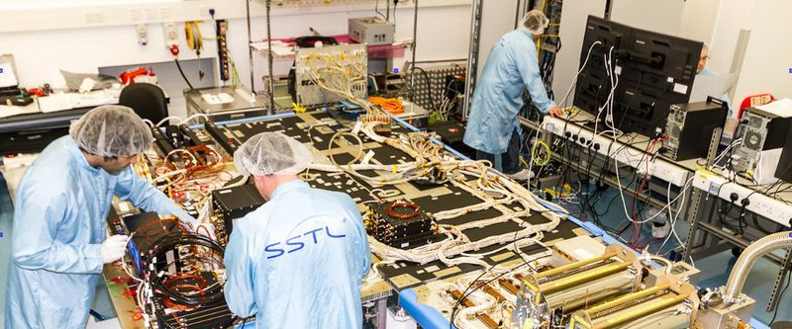
2014
Production of the first Mars communication satellite.

Slide 5
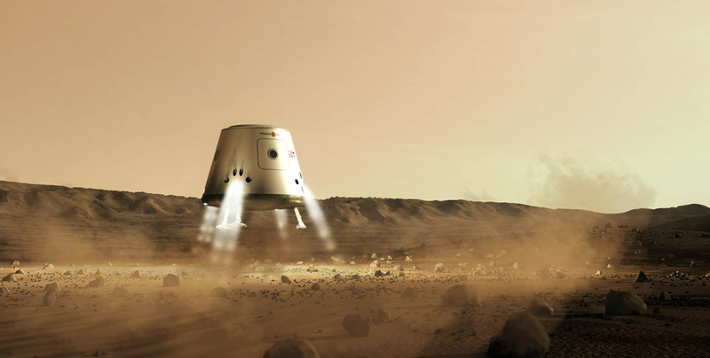
2016
Supply mission launched to Mars.

Slide 6
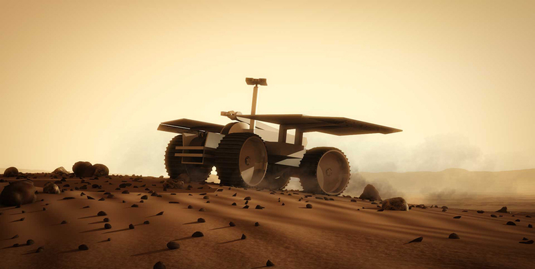
2018
Rover lands on Mars

Slide 7
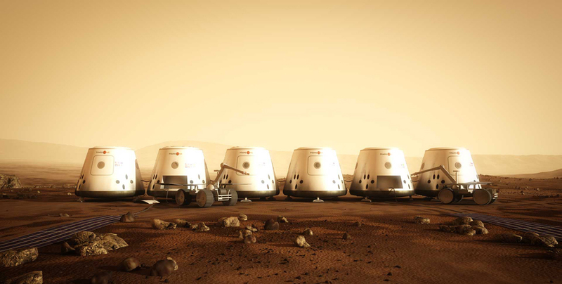
2021
Habitable settlement created

Slide 8
2022
Liftoff to the Mars

Slide 9
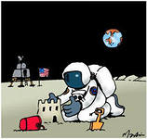
2023
Landing on the Mars.

Slide 10
Thank you.

